Slide 1


CIE 337
Final Project
Presented by:
Enji Wael
Youssef Said

Slide 2
Outline
Project Overview
Test Cases and Outputs
Notes:
Hello

Slide 3
Project Overview
1

Slide 4
Part I

Slide 5
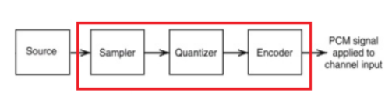
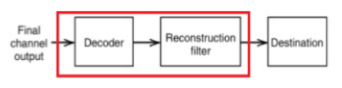
Block Diagram:

Slide 6
Pulse Code Modulation (PCM):
Pulse Code Modulation (PCM) is a method employed to transform an analog signal into a digital format by encoding its amplitude into a sequence of discrete pulses. This technique is fundamental for the digital representation of various types of analog signals, including audio and voice, enabling their efficient transmission, processing, and storage in digital systems.

Slide 7
[1] Sampling:
According to the Nyquist theorem, the sampling rate must be at least twice the highest frequency component of the analog signal to prevent aliasing.
At each sampling interval, the amplitude of the analog signal is measured and recorded as a discrete value. The result is a series of discrete samples that represent the original continuous signal.

Slide 8
[2] Quantization:
Quantization Levels are Determined by the bit depth of the PCM system. For example, an 8-bit quantizer has 256 possible levels (2^8), while a 16-bit quantizer has 65,536 levels (2^16). Higher bit depths provide more precise representations of the analog signal.
Each sampled value is approximated to the nearest level from a finite set of discrete values.

Slide 9
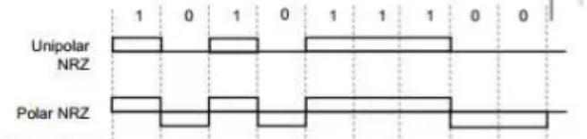

[3] Encoding:
The quantized values are converted into binary codes.
The resulting binary sequence is a stream of encoded values that can be transmitted over digital communication channels or stored in digital media.

Slide 10
[4] Decoding:
The binary sequence is interpreted to retrieve the corresponding quantized value.

Slide 11
[5] Reconstruction Filter:
After decoding, the quantized values are used to reconstruct the analog signal. This involves interpolation to smooth out the discrete values and approximate the continuous waveform.
A low-pass filter is used to smooth the reconstructed signal and remove artifacts introduced during quantization.

Slide 12
Test Cases For Part I
2

Slide 13
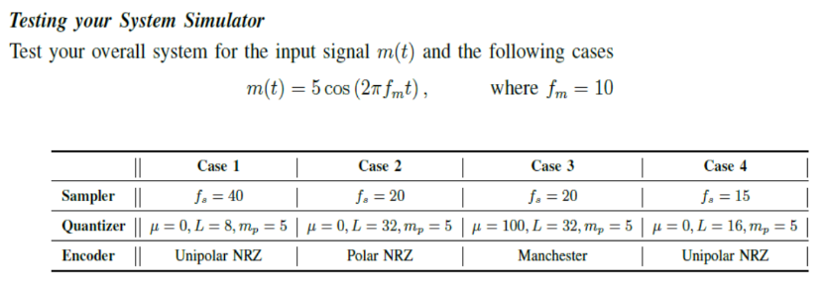
Test Cases:

Slide 14
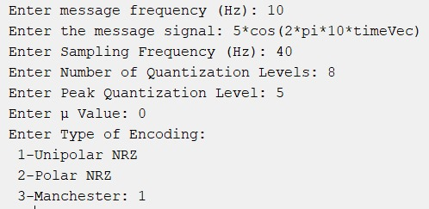
Test Case 1:

Slide 15
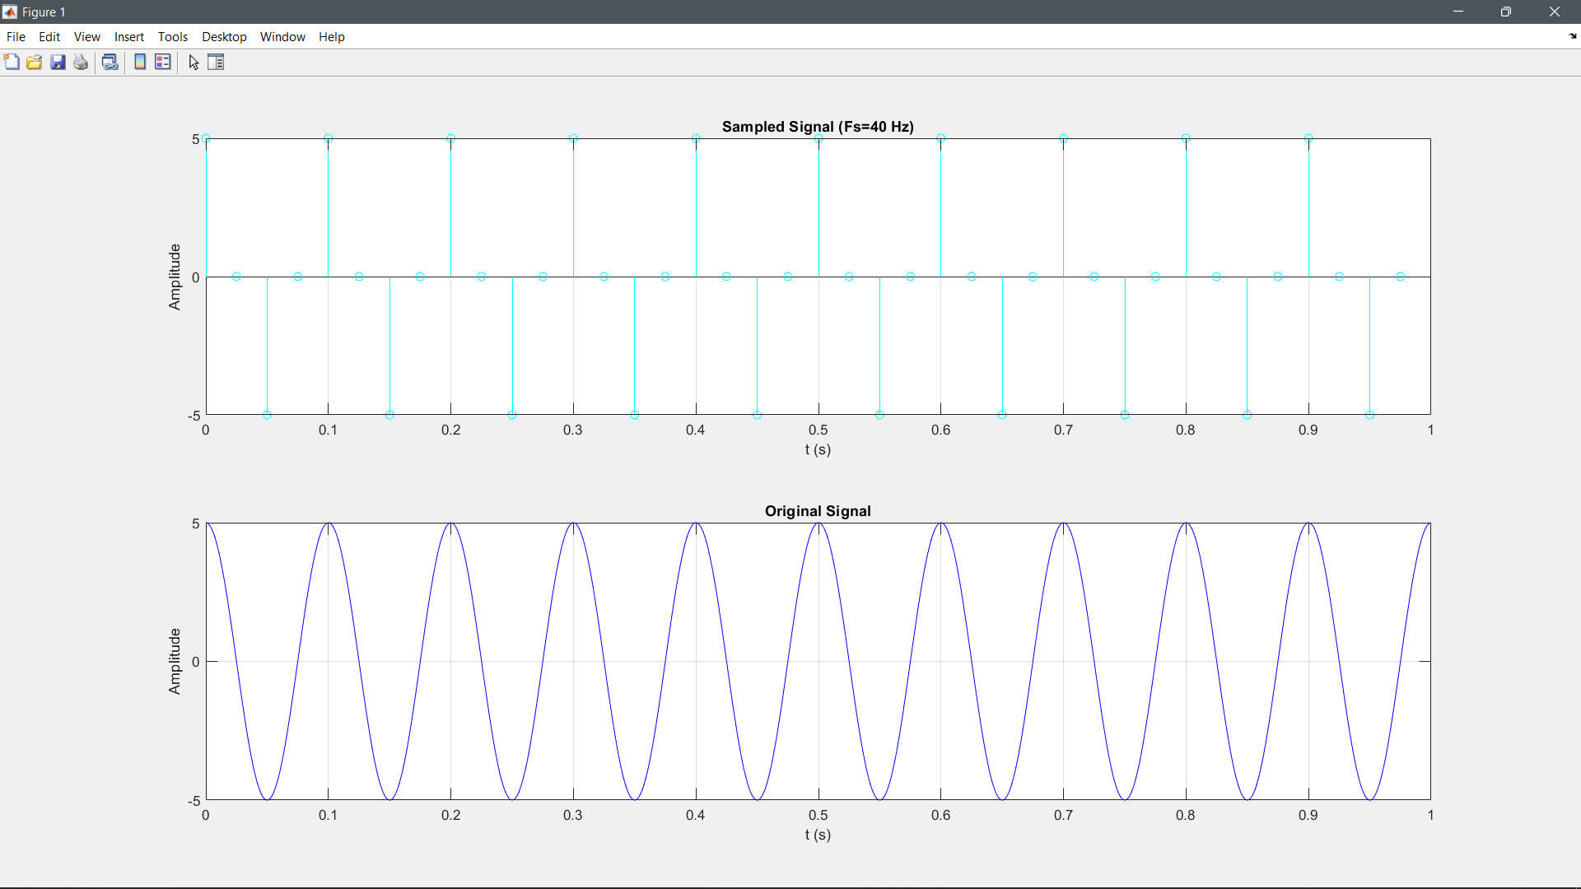

Slide 16
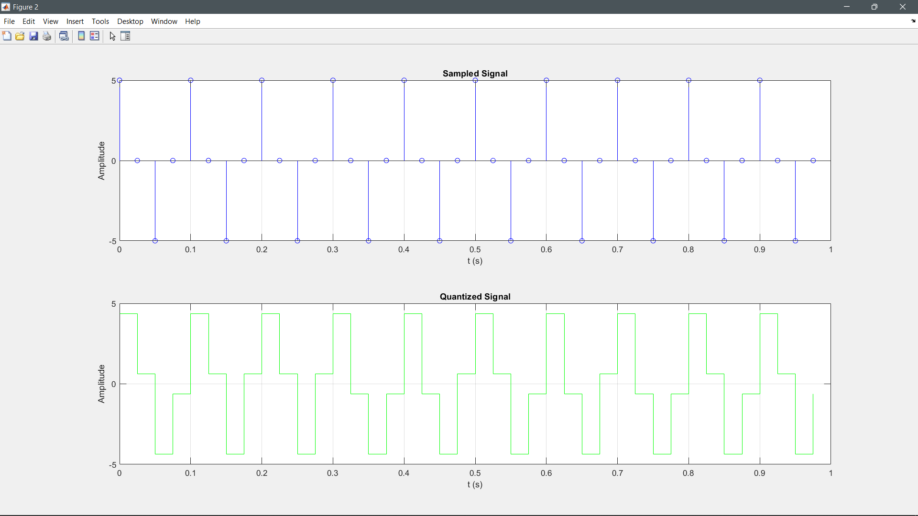

Slide 17
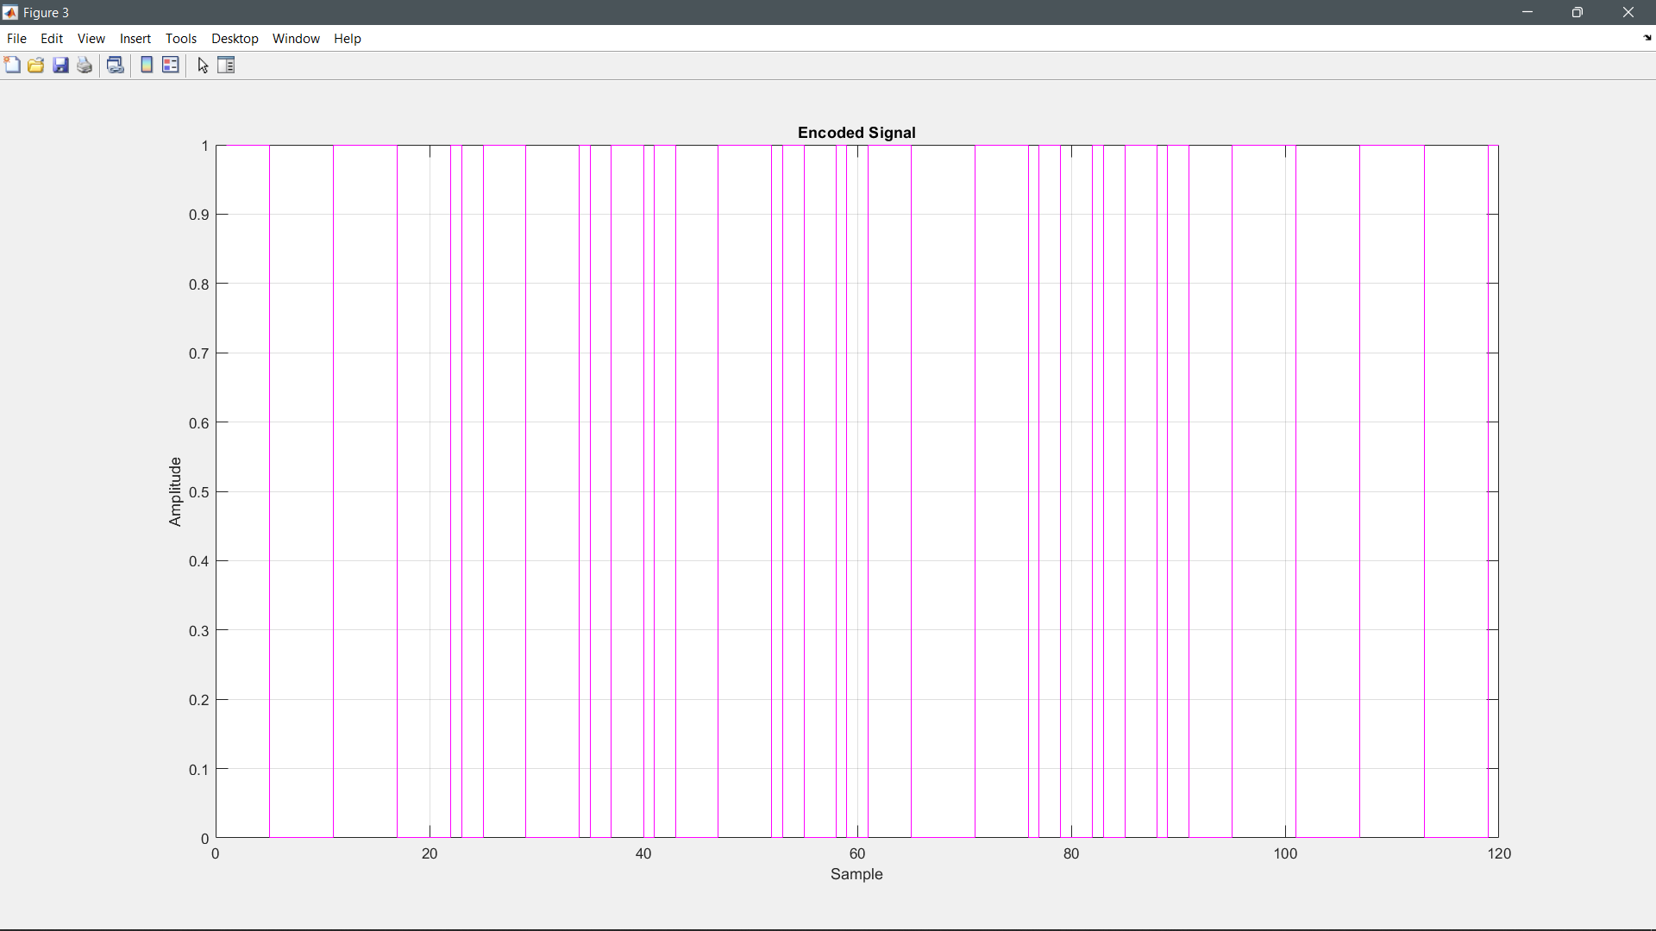

Slide 18
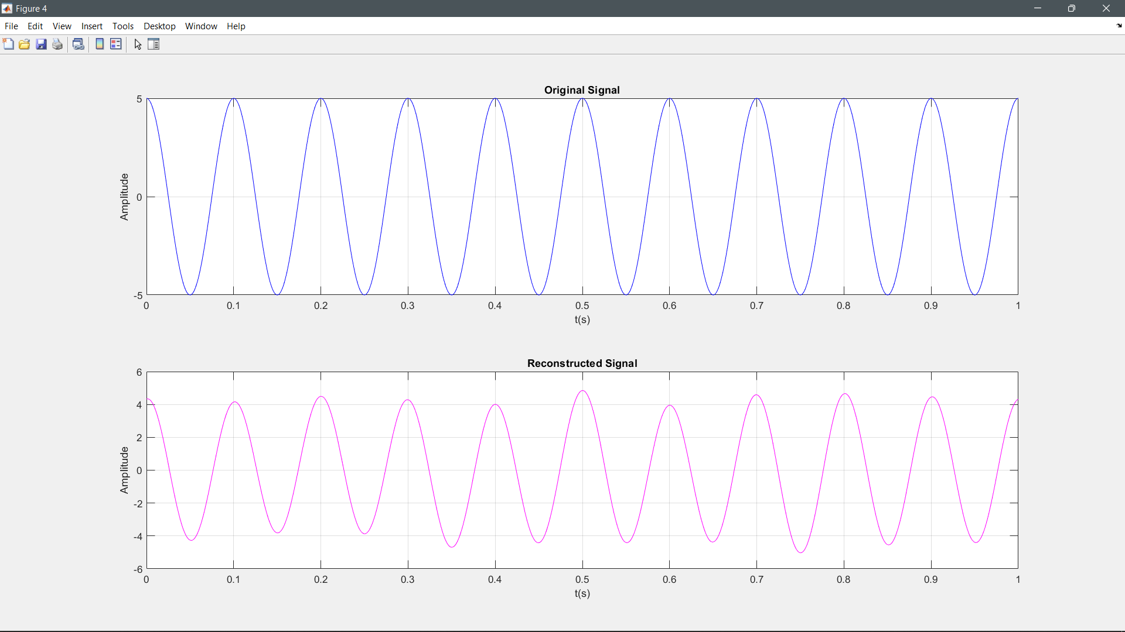

Slide 19
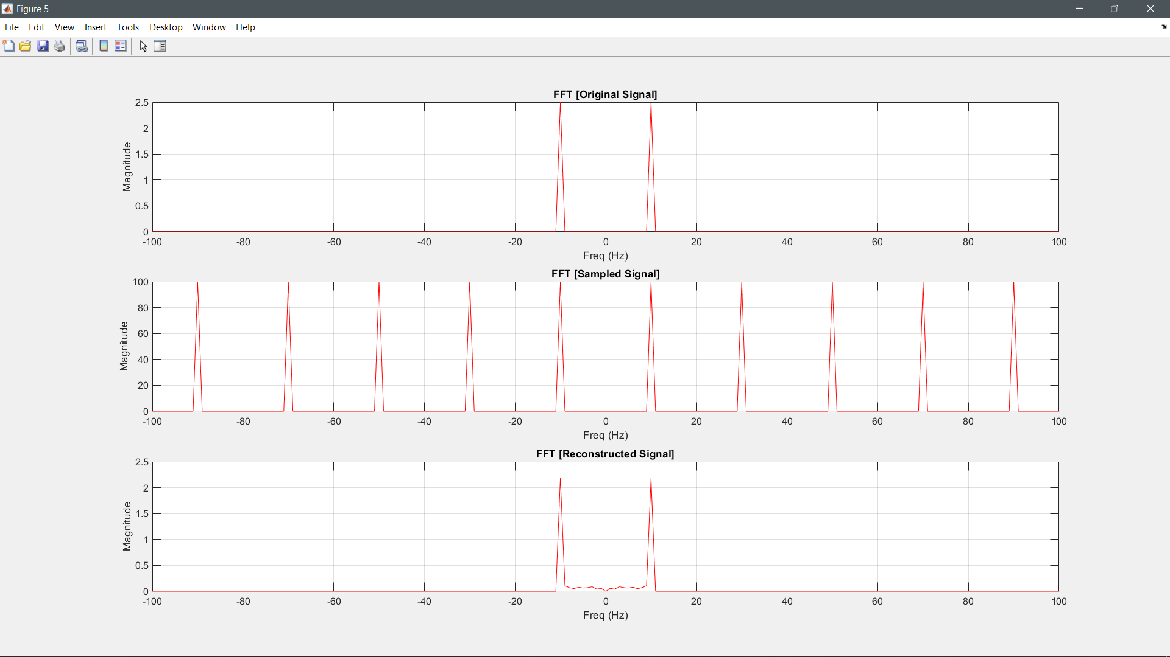

Slide 20
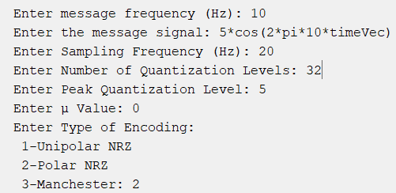
Test Case 2:

Slide 21
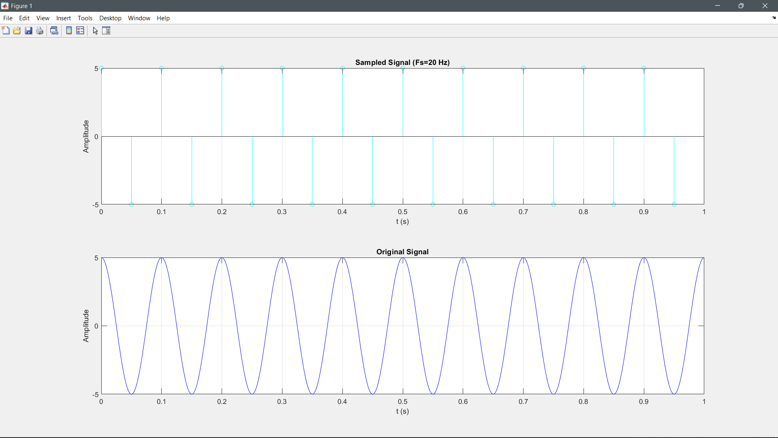
Test Case 2:

Slide 22
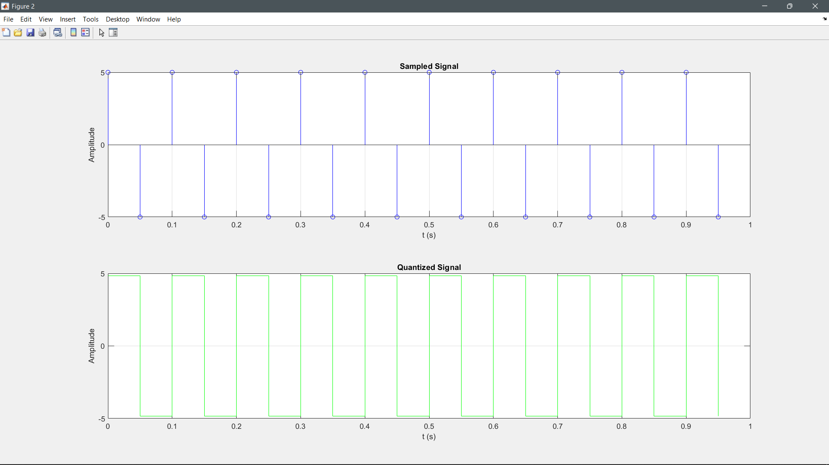

Slide 23
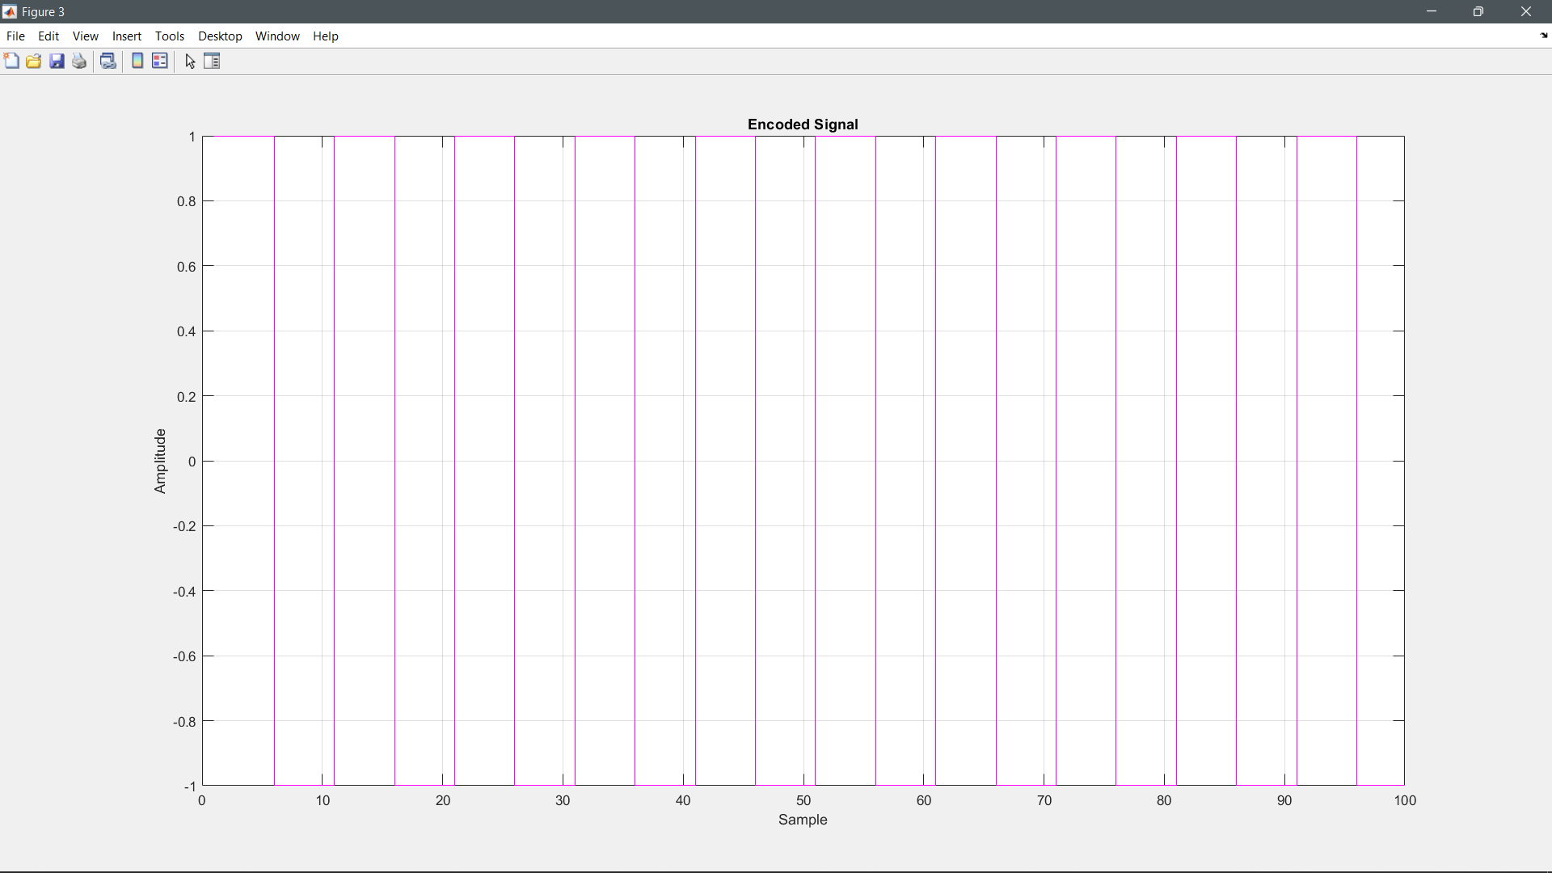

Slide 24
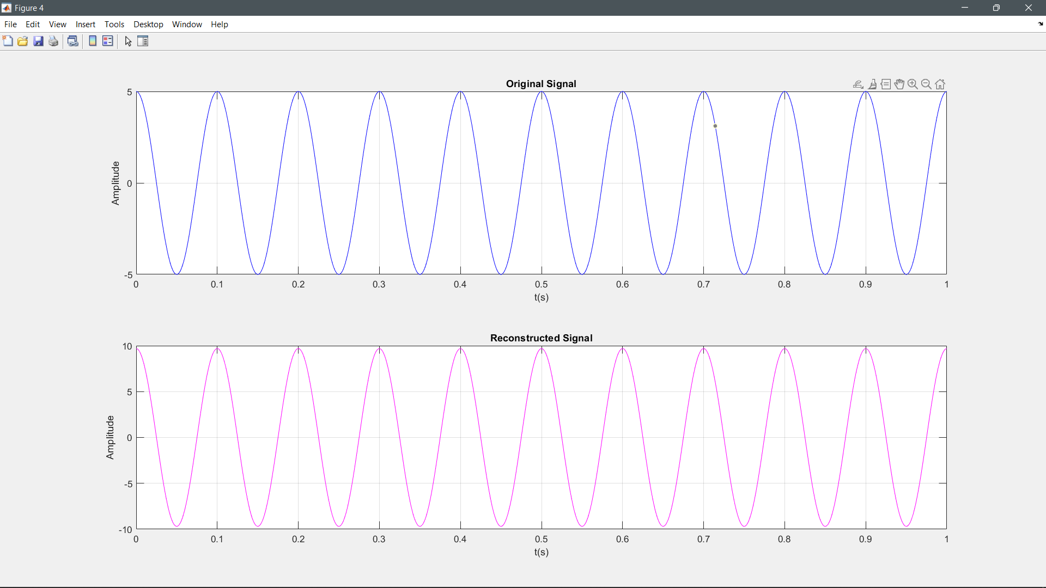

Slide 25
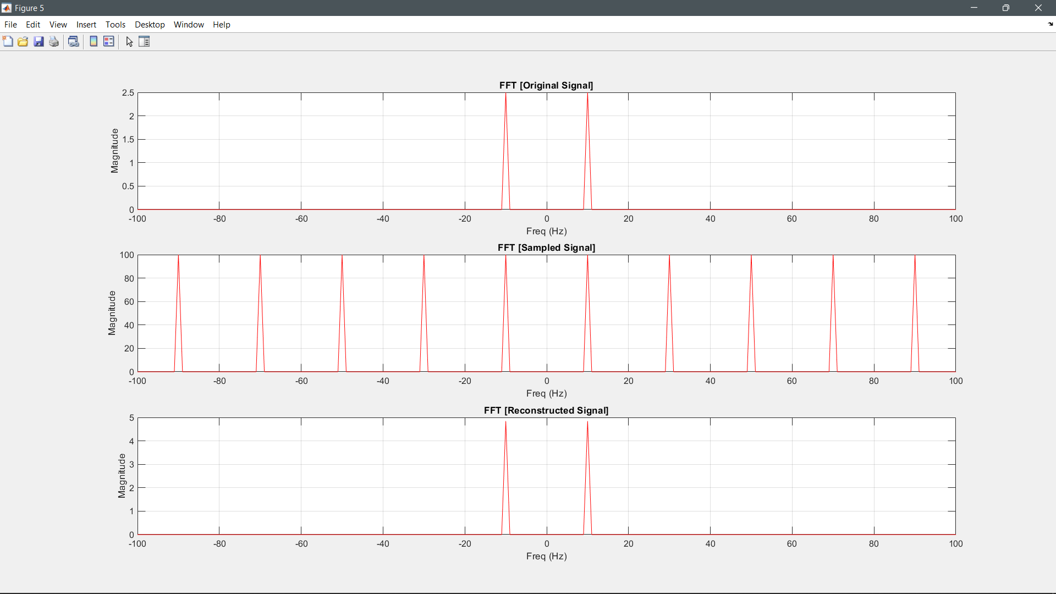

Slide 26
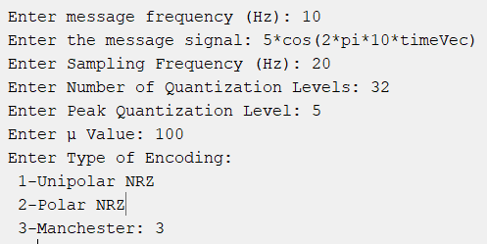
Test Case 3:

Slide 27


Slide 28


Slide 29
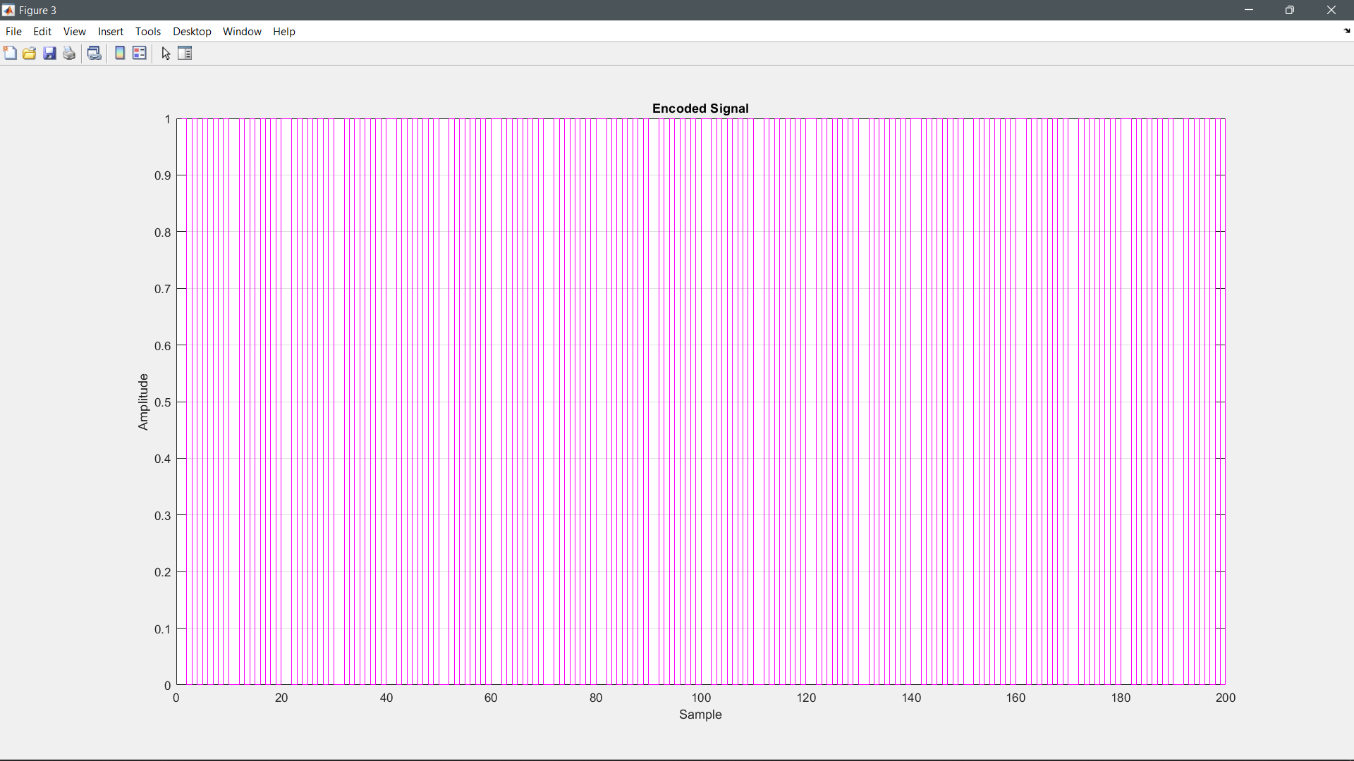

Slide 30
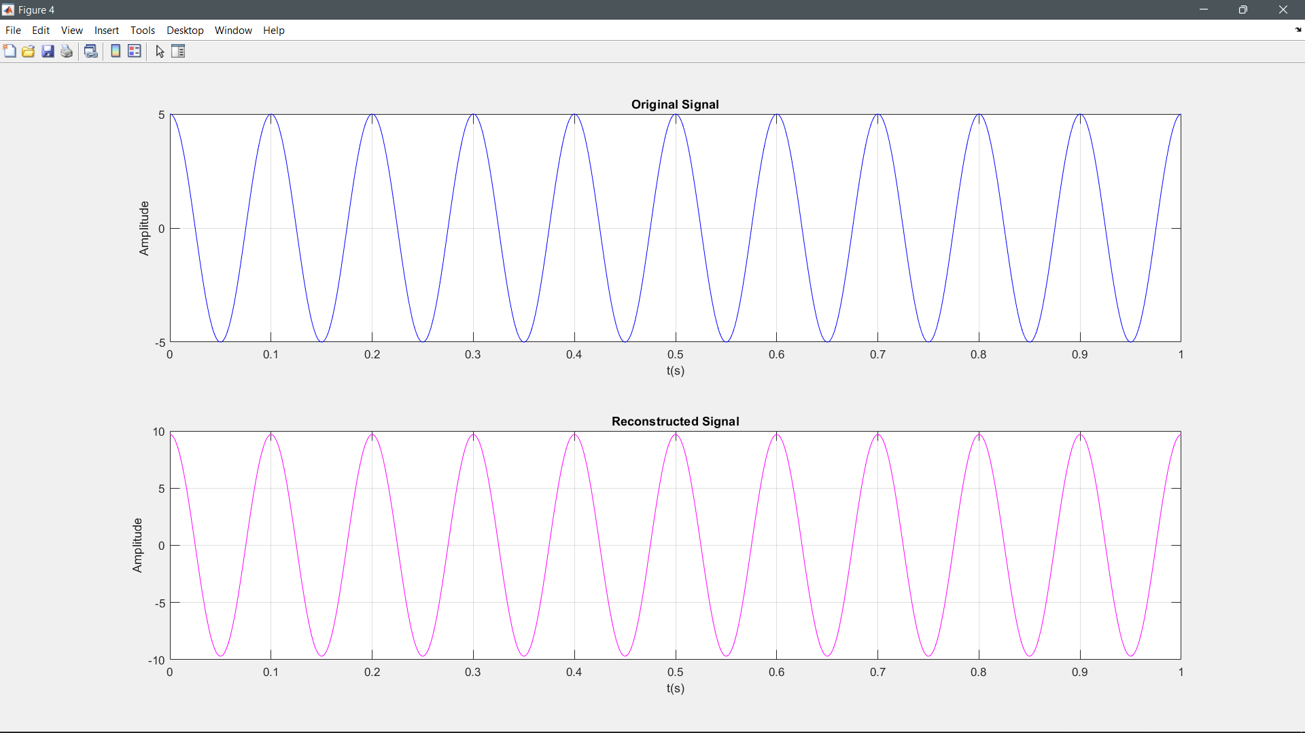

Slide 31


Slide 32
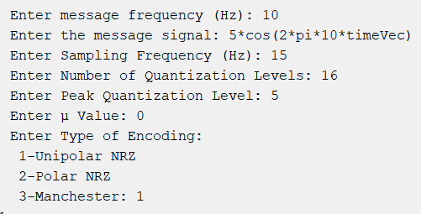
Test Case 4:

Slide 33
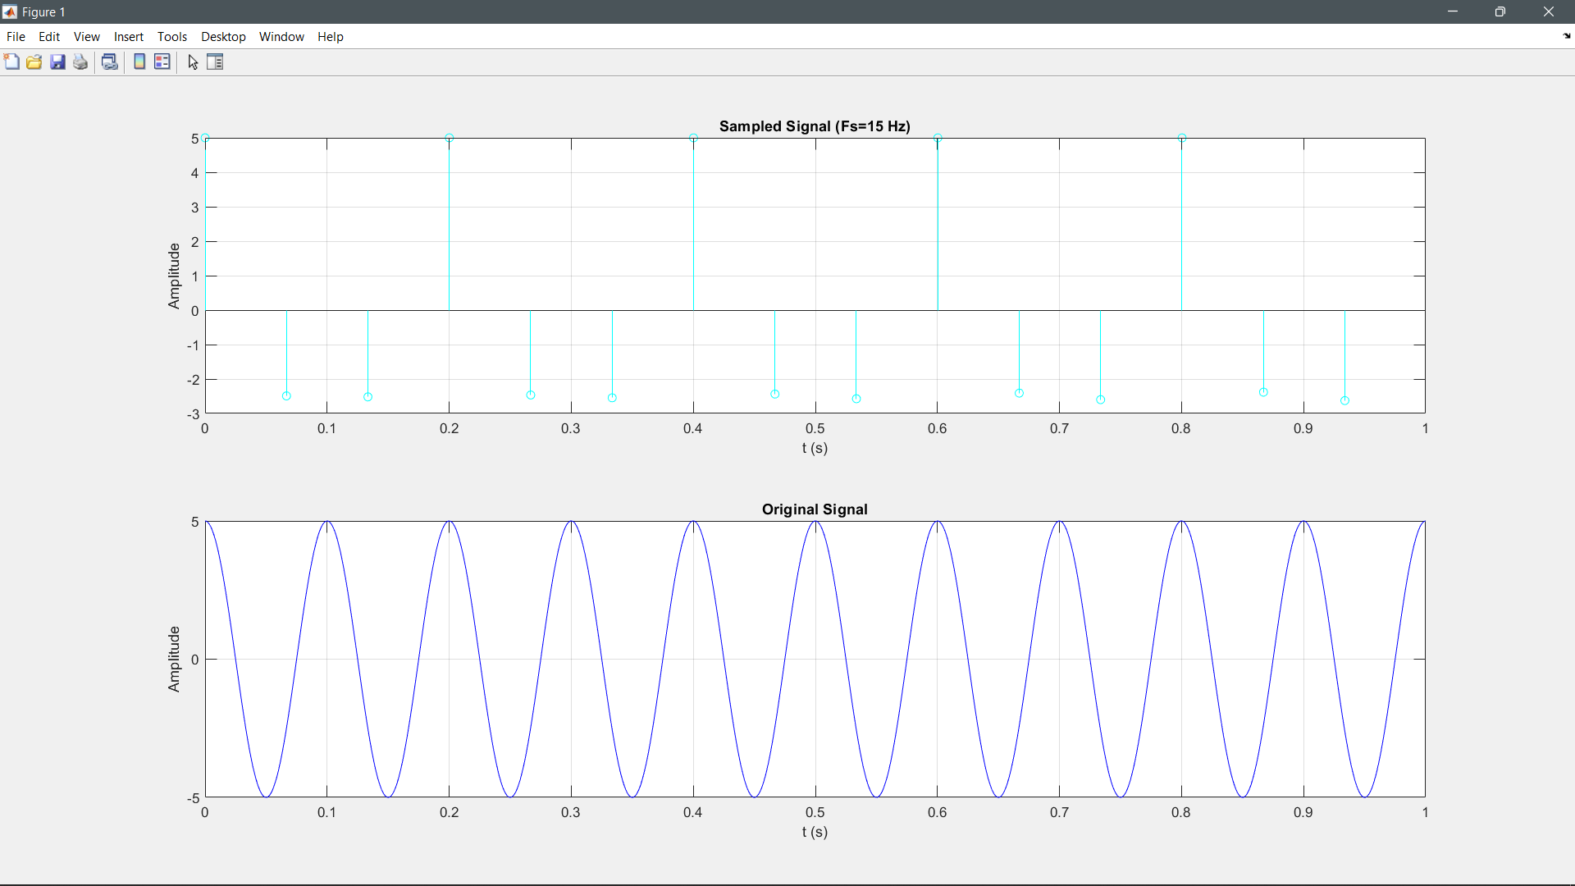

Slide 34
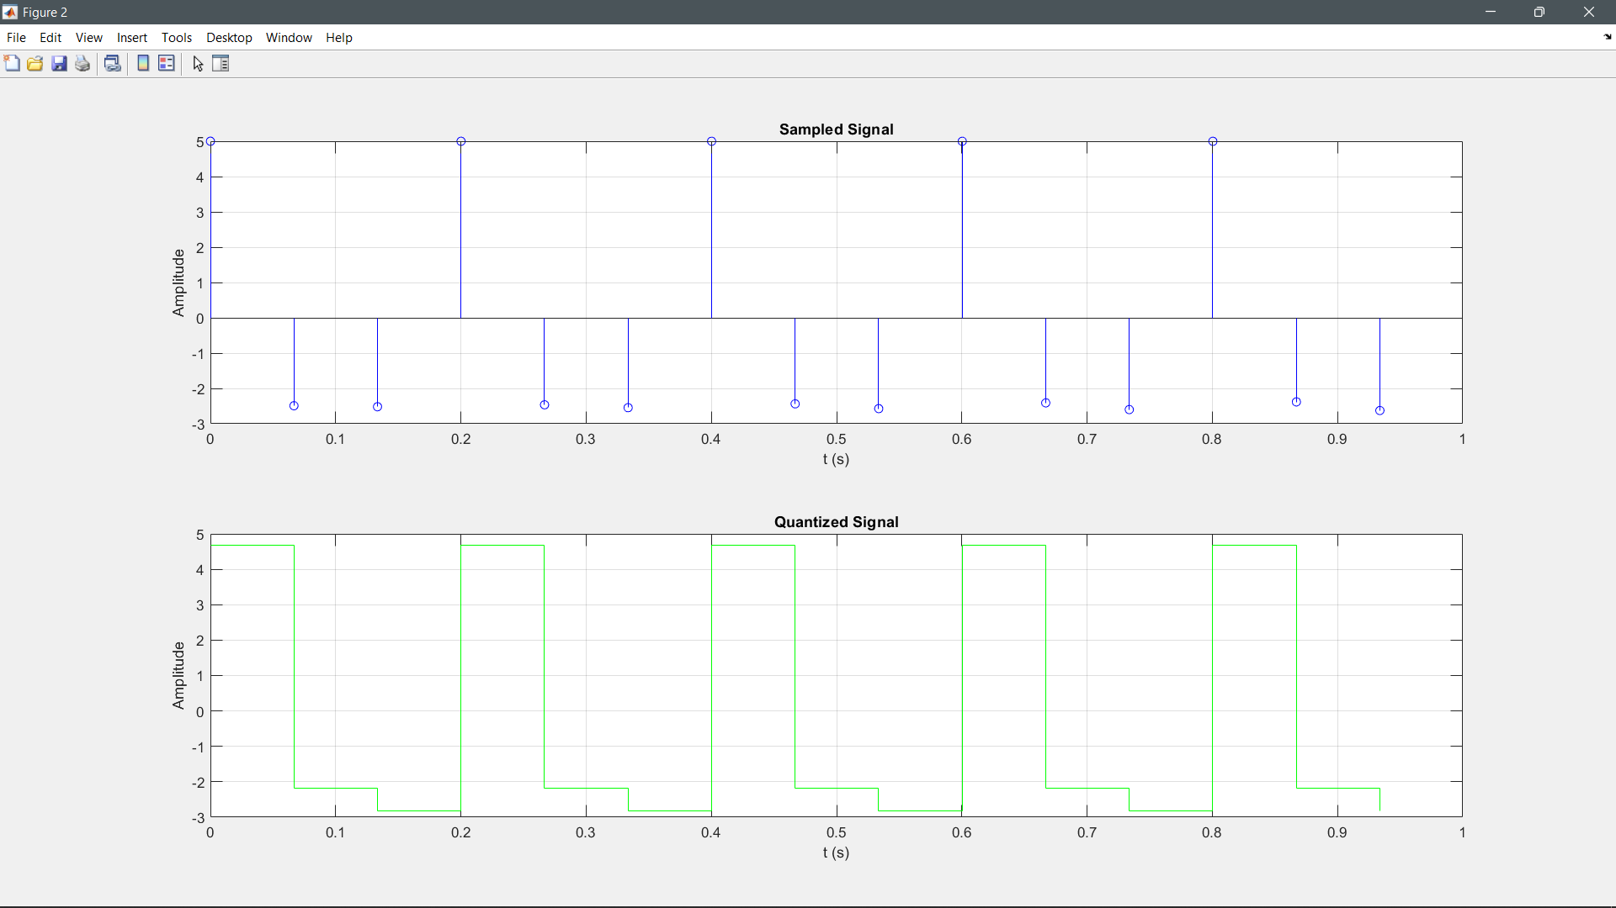

Slide 35
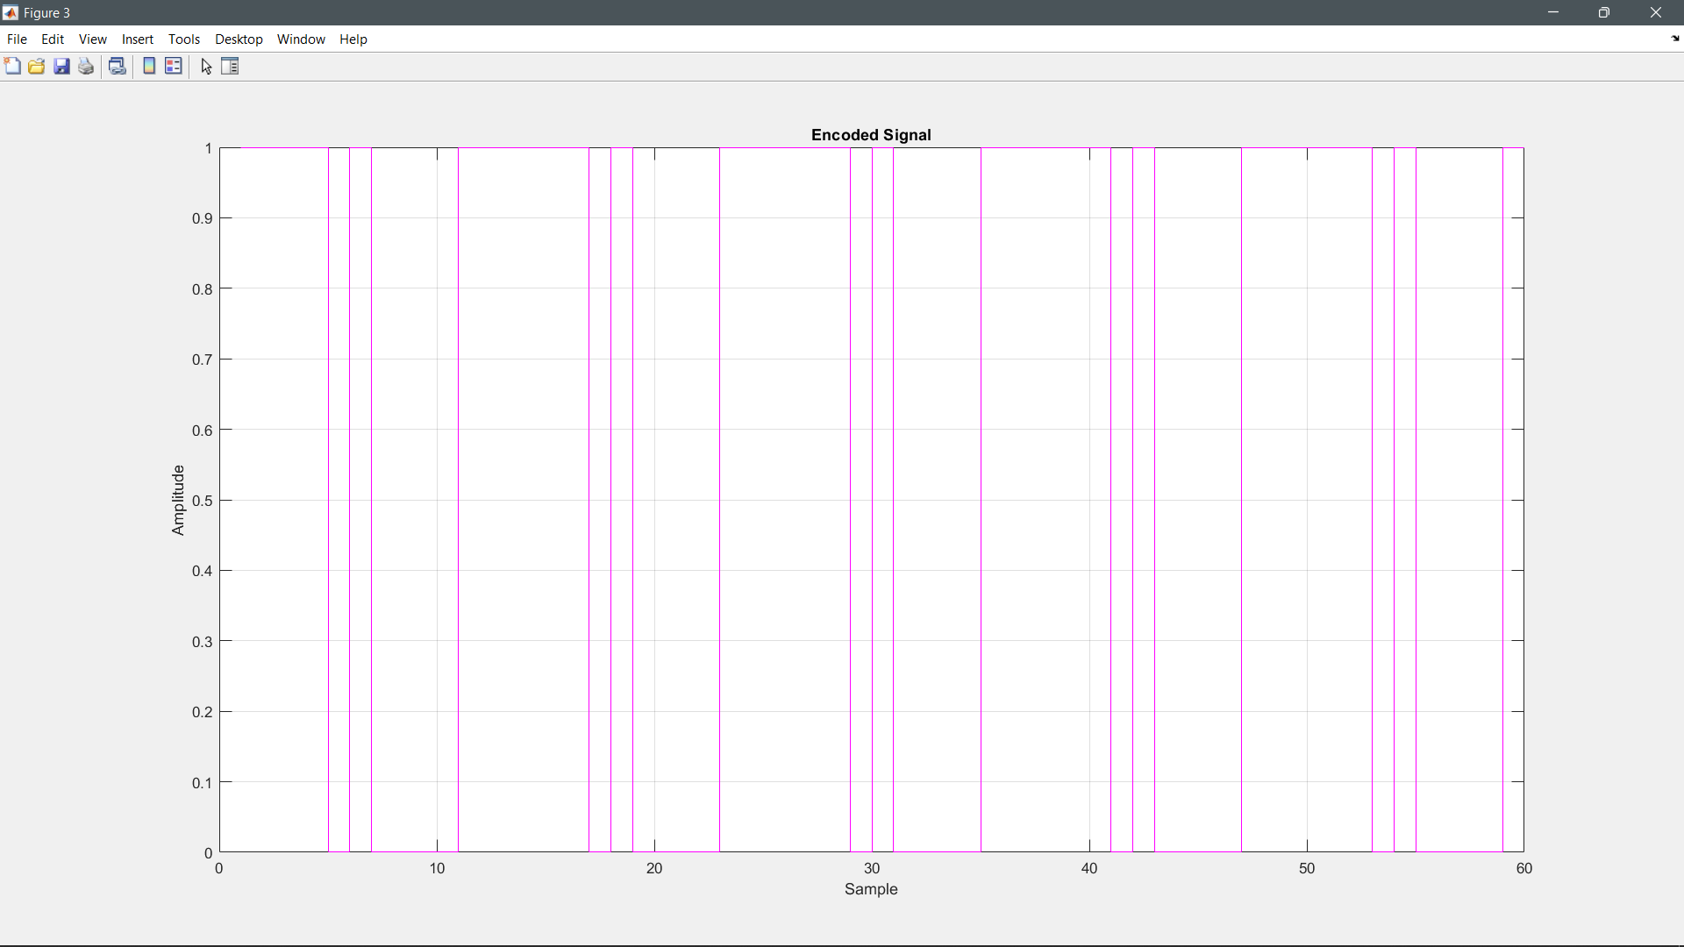

Slide 36
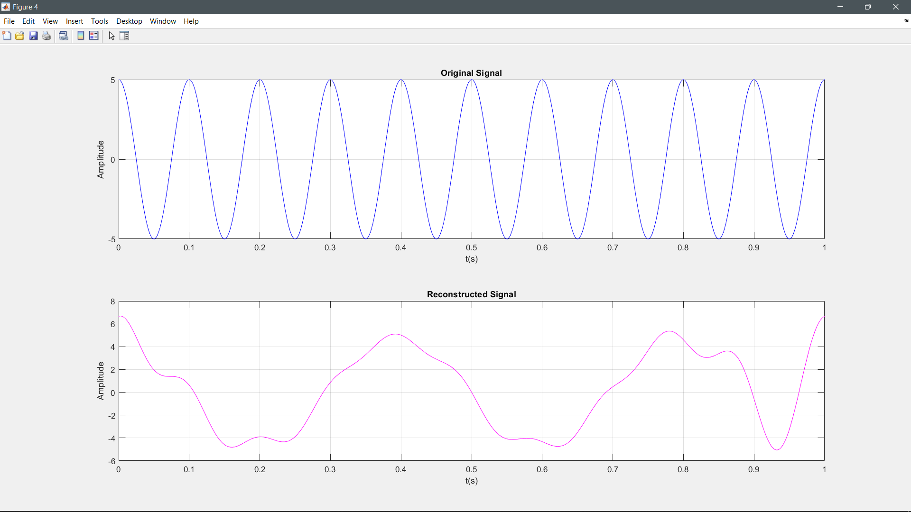

Slide 37
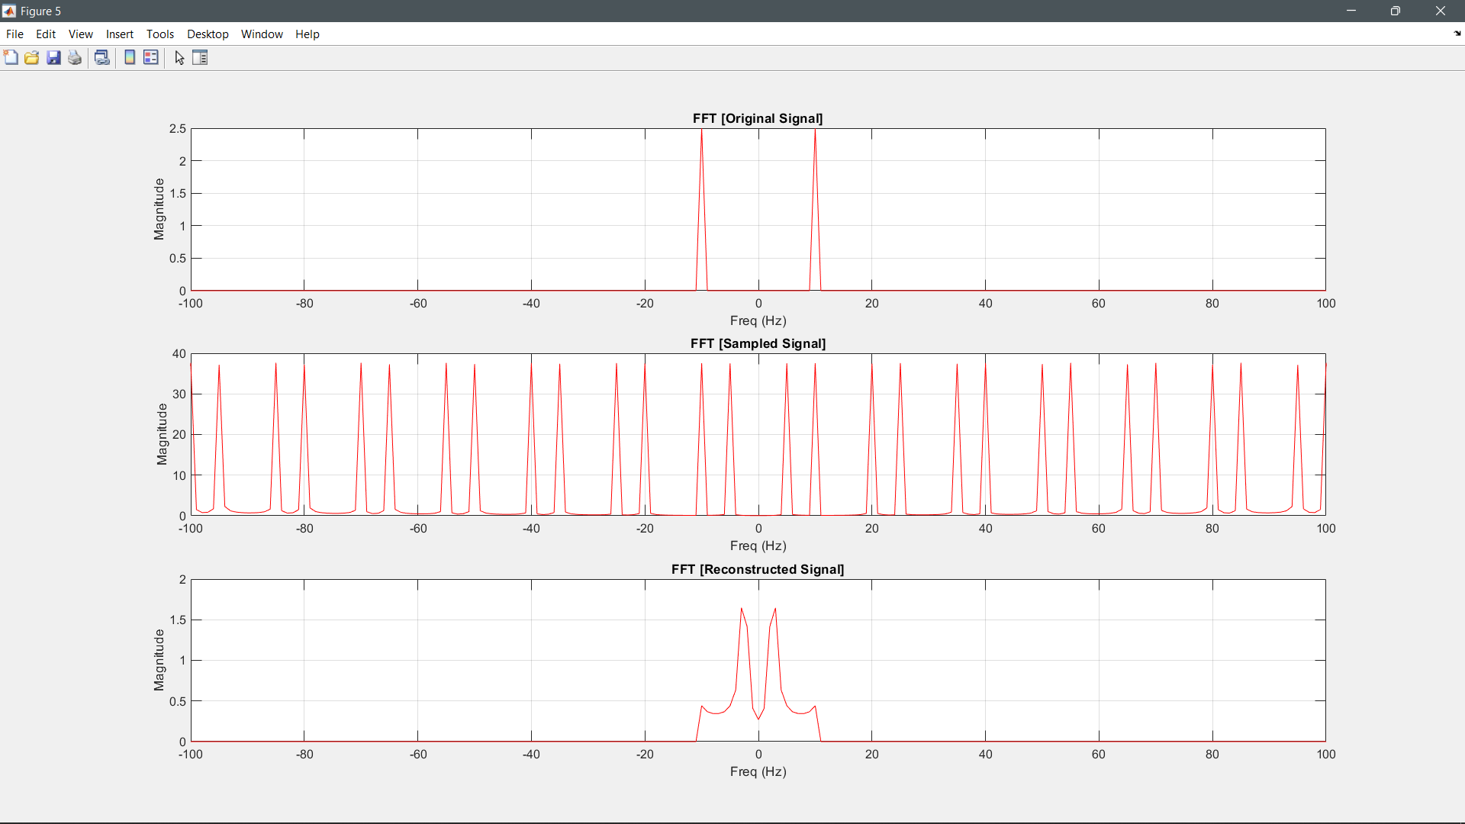

Slide 38
Part II

Slide 39
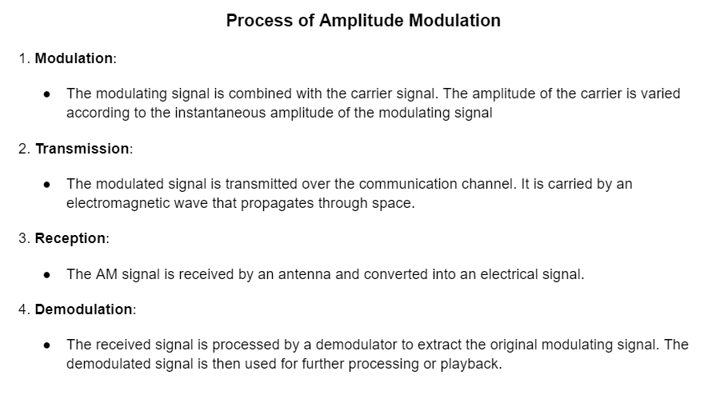
AM Modulation:

Slide 40
Signals used in AM Modulation:
Message Signal:
fm = 200;
ym = Am * cos(2 * pi * fm * t);
Carrier Signal:
fc = 2000;
yc = Ac * cos(2 * pi * fc * t);

Slide 41
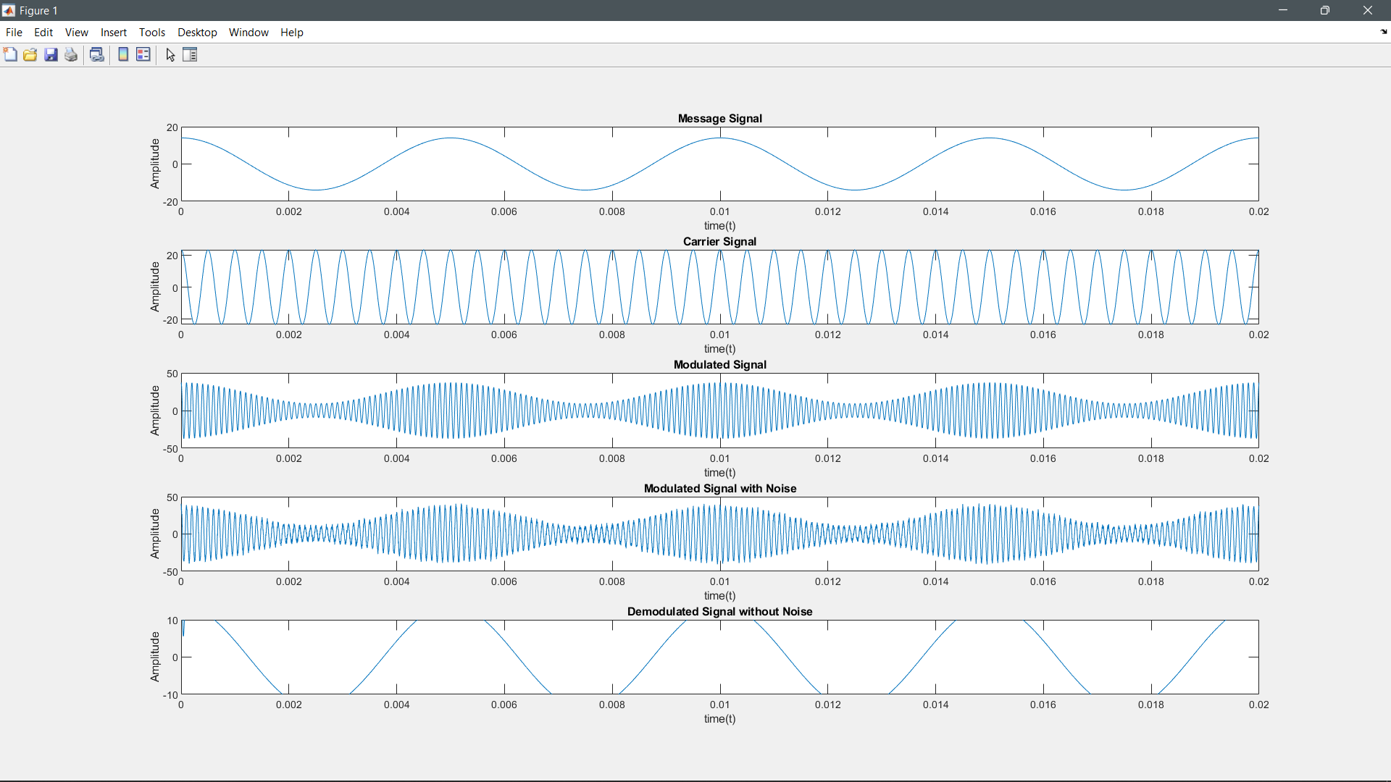

Slide 42
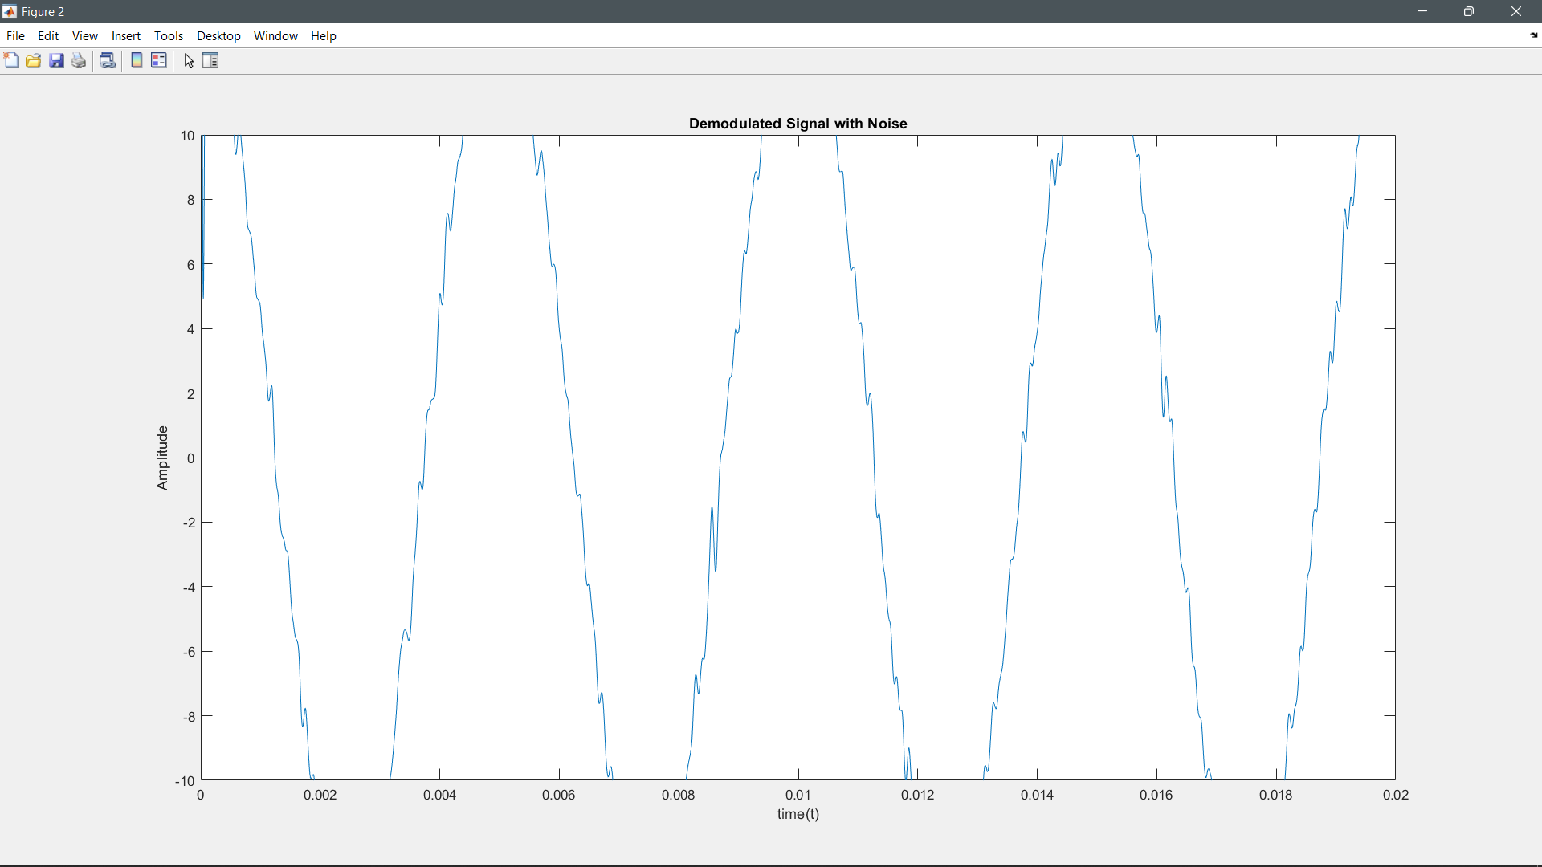

Slide 43
Thank
You

